Slide 1
TRANSLATION STAGE CONTROL
For EvWaCo Prototype
Present by Nunnalin Auephattanaphong (Internship)
Robotics Engineering and AI, CMU.

Slide 2
1
ABOUT INTERNSHIP PROJECT
2
Get to know instruments
Agenda
Error Measurement Method
3
Experiment & Application
4
Conclusion
5

Slide 3
01
About Internship project
1

Slide 4
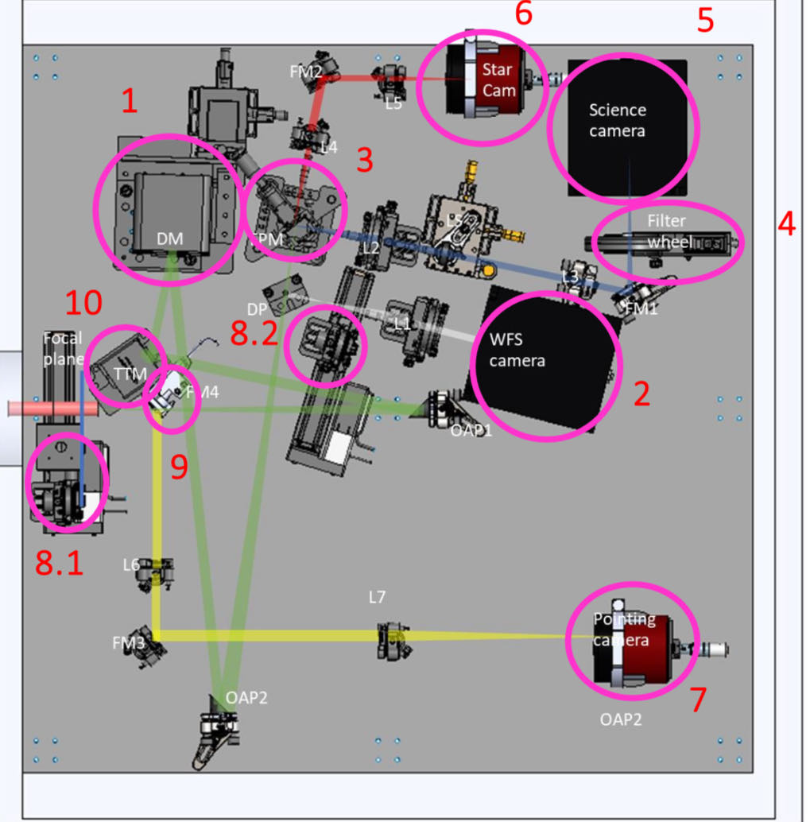
Introduction
Translation stage control project is a mini project that part of Evanescent Wave Coronagraph (EvWaCo) prototype project from NARIT.
Evanescent Wave Coronagraph or EvWaCo is a type of Lyot coronograph that aim to develop optical instruments for collect the starlight and companion light.
The main idea of translation stage control project is
control translation stage moving along horizontal axis for moving light source
to make the light source closest align
2
Notes:
control translation stage moving light source along horizontal axis to make the light source closest align to imaging system for get high quality image by using PID closed loop control .

Slide 5
Why we use PID Control ?
Stability and Responsiveness : The D term dampens oscillations, while the I term corrects steady-state errors, leading to a more stable system.
Improved Accuracy : The I term ensures the system output matches the desired setpoint more precisely.
Flexibility : PID provides three tunable parameters (Kp, Ki, Kd) to optimize performance for different systems and dynamic behaviors.
In summary, PID control offers balanced error management, enhancing stability, accuracy, and responsiveness over pure error control.
3

Slide 6
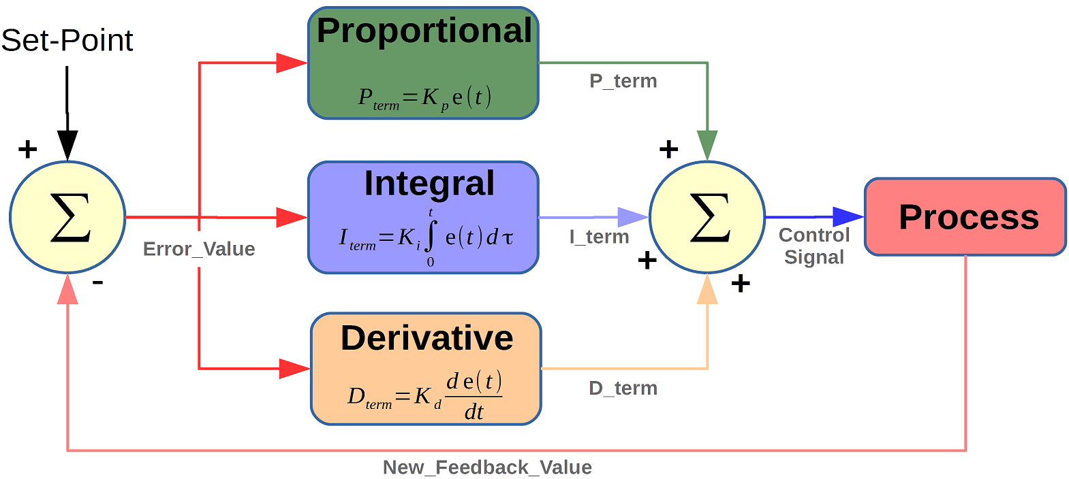
PID CONTROLLER
Stands for “Proportional, Integral, Derivative” .
It is closed-loop feedback control .
instrument used by control engineers to regulate temperature, flow, pressure, speed, and other process variables in industrial control systems.
https://microcontrollerslab.com/pid-controller-implementation-using-arduino/
4

Slide 7
PID CONTROLLER
P : Proportional
tuning -> correcting a target proportional to the difference
based on the current error ( setpoint - measured output of the system )
I : Integral
tuning -> cumulating the error result from the “P” action to increase the correction factor
Increase the contribution of the accumulated error over time to the control signal
D : Derivative
tuning -> minimize overshoot by slowing the correction factor
reduce the rate of change of the error
helps improve the stability and responsiveness of the control loop
5

Slide 8
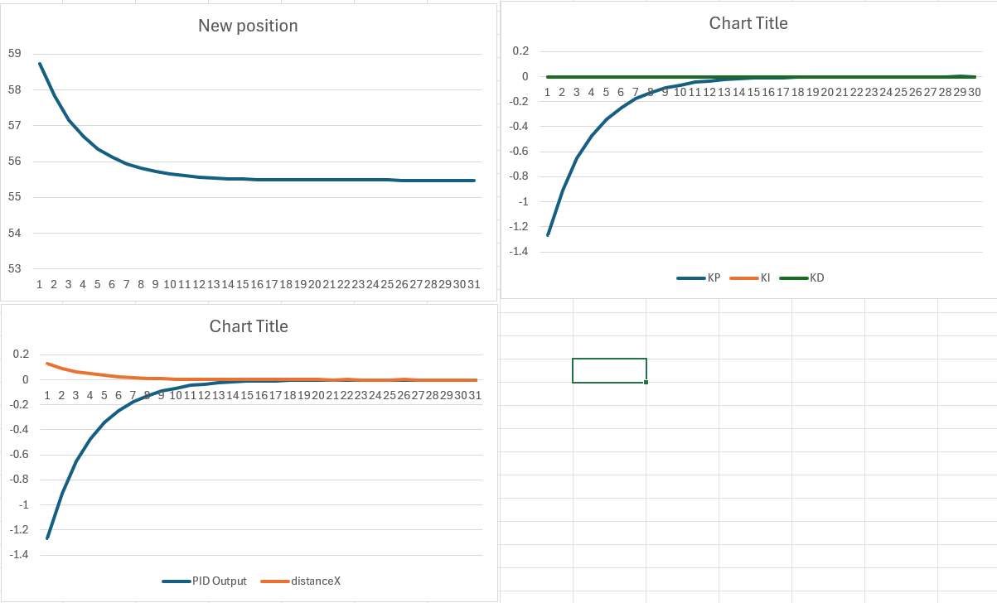
PID CONTROLLER
P Controller
Use only error term to affect the output
mm
Translation stage position
P,I,D term
simply multiply error with the gain constant
t
Kp * e(t)
t
provides a linear relationship between the error of a system and the controller output of the system
Relation between PID Output and error (e(t))
t
error
6

Slide 9
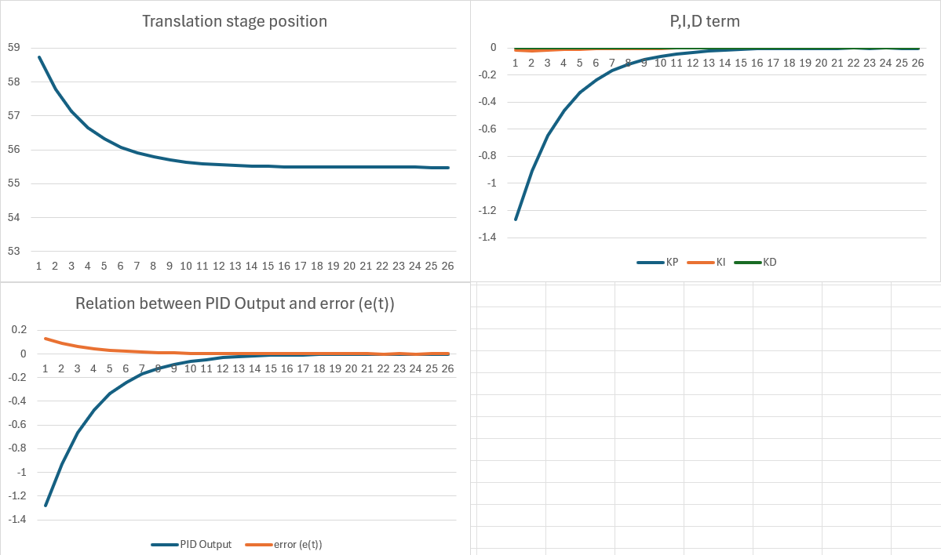
PID CONTROLLER
PI Controller
a combination of Proportional controller action and Integral controller action
correlates the controller output to the error and the integral of the error.
provides a faster response time than
I-only control
Eliminates steady state error
7

Slide 10
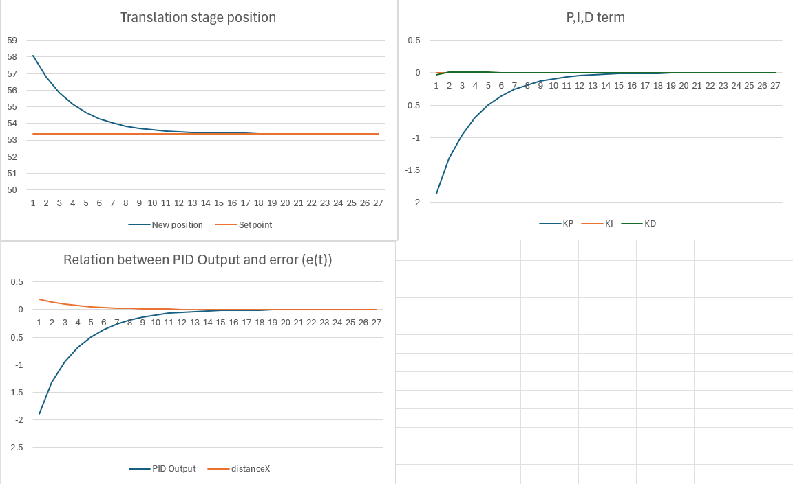
PID CONTROLLER
PD Controller
combination of feedforward and feedback control
contains - proportional control’s damping
of the fluctuation
- derivative control’s prediction
of process error output
Improves transient response, reduces overshoot
error
8

Slide 11
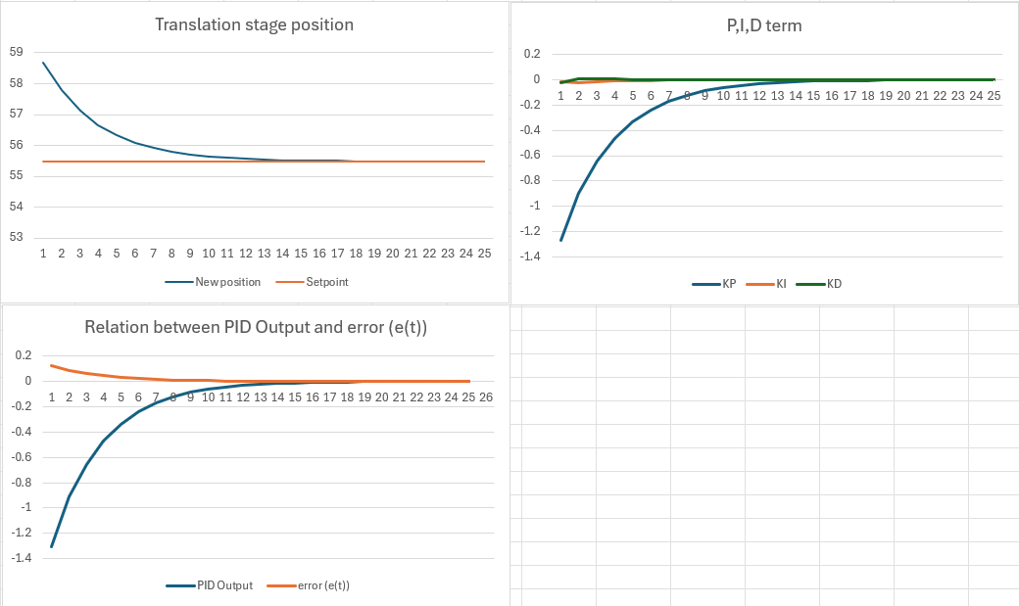
PID CONTROLLER
PID Controller
a combination of all three types of control methods
most commonly used
balances steady state and transient response
9

Slide 12
02
Get to know instruments
10

Slide 13
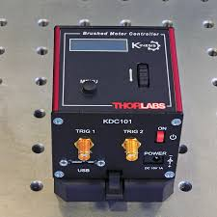
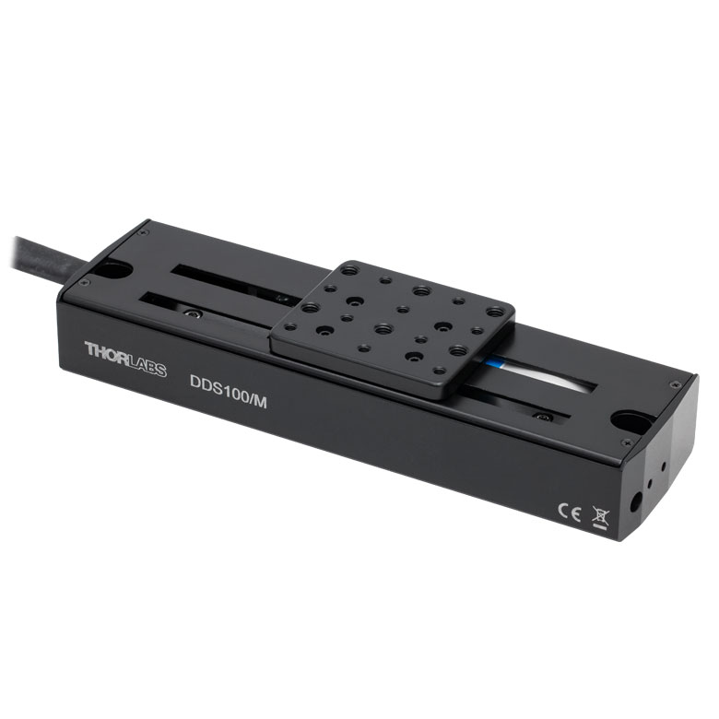
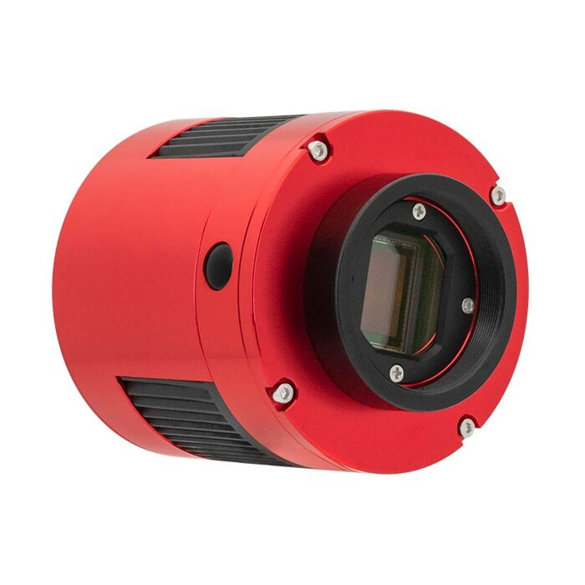
INSTRUMENTS
Mainly focus on
KDC101 -> Controller for control DDS100/M
DDS100/m -> One axis translation Stage
ASI1600mm PRO -> Camera for capture images
KDC101
DDS100/M
ASI1600mm PRO
chrome-extension://efaidnbmnnnibpcajpcglclefindmkaj/https://optomechs.com/pdf/manuals/KDC101/KDC101_ManualforKinesis.pdf
https://www.thorlabs.com/thorproduct.cfm?partnumber=DDS100/M
https://telescopes.net/zwo-asi1600mm-pro-monochrome-cmos-camera.html
Optical components
Light source
Mirrors
lens
11

Slide 14
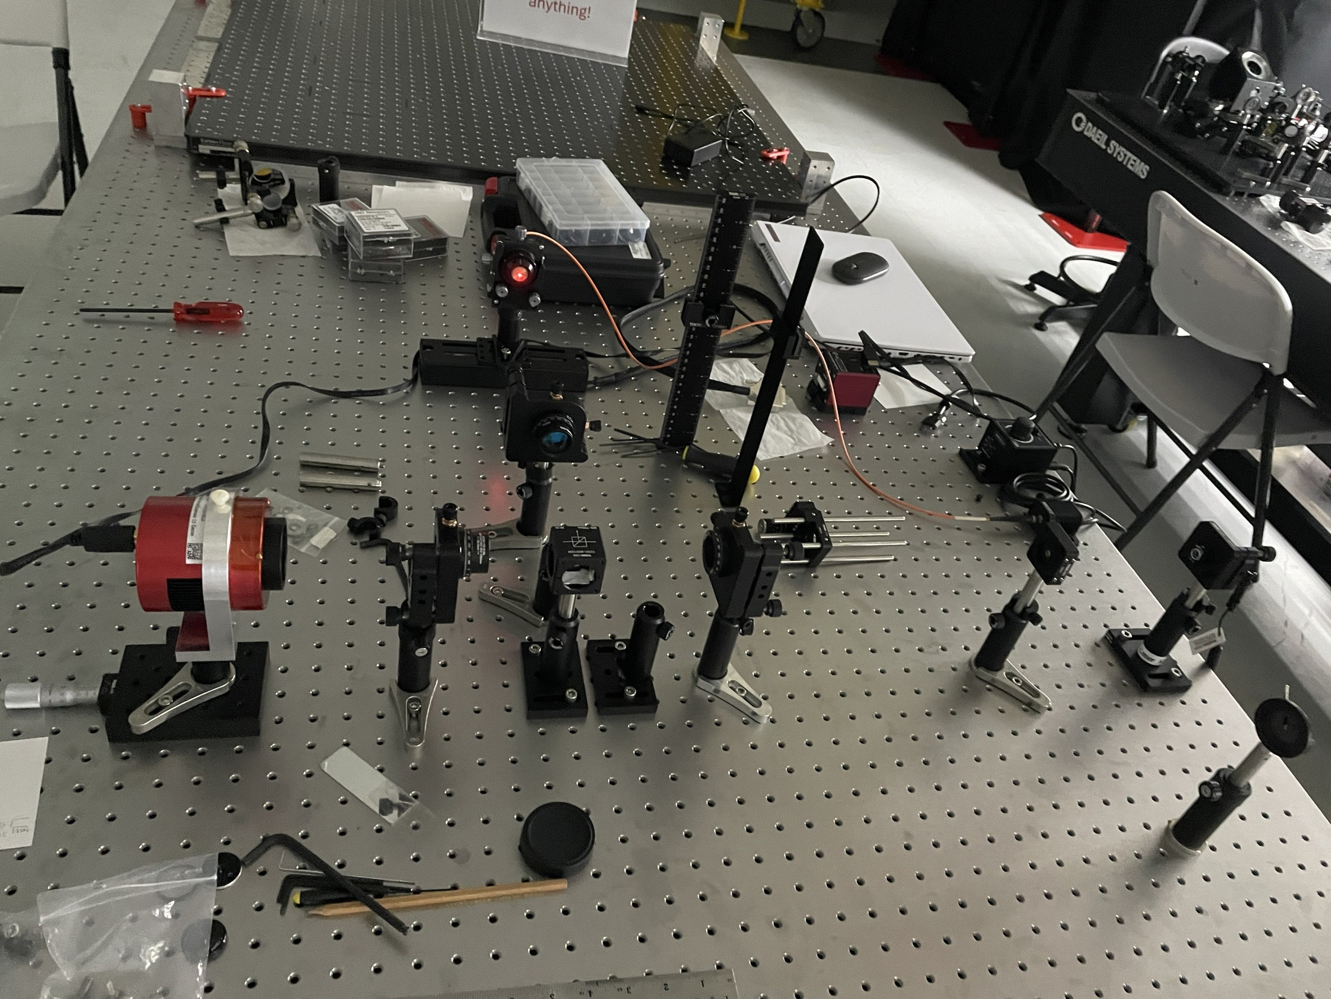
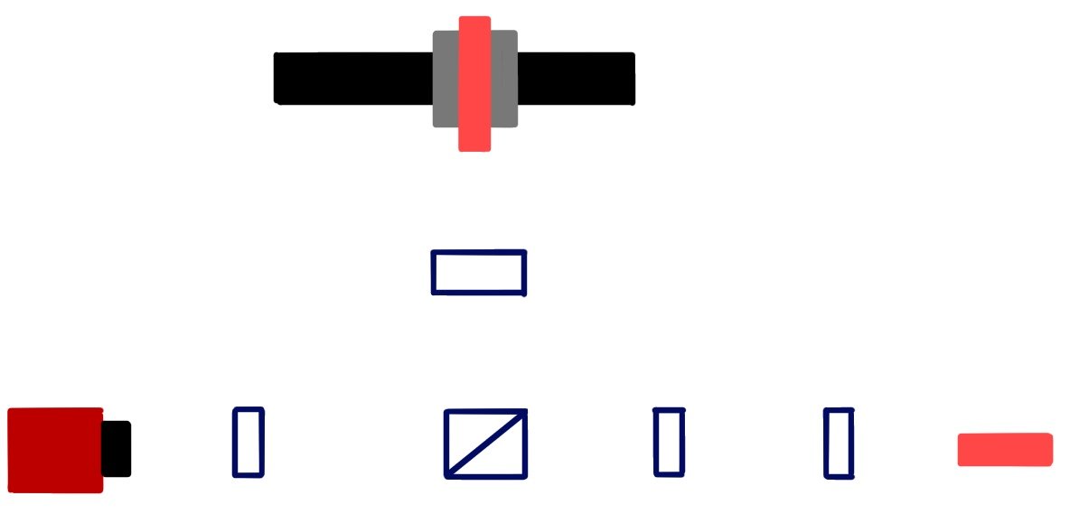
SETUP
Translation stage with light source
Lens
Lens
Mirror
Lens
Lens
ASI1600mm-PRO
Reference Light source
Schematic
12

Slide 15
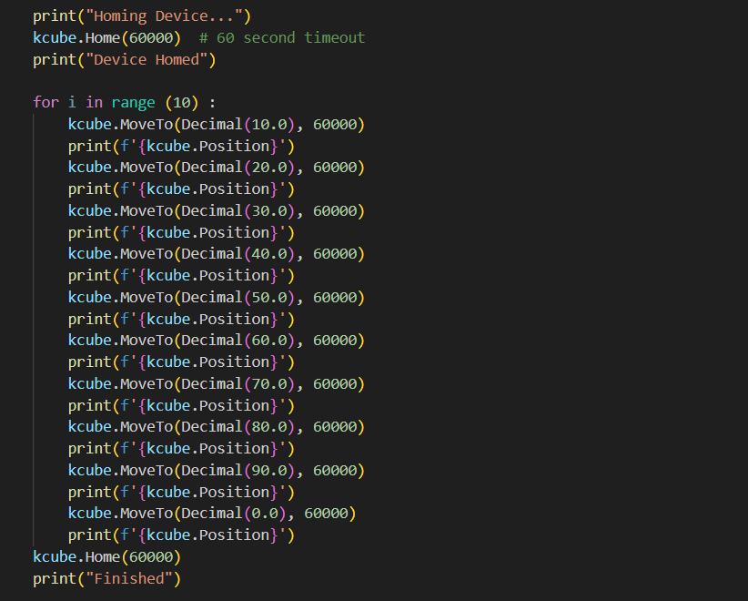
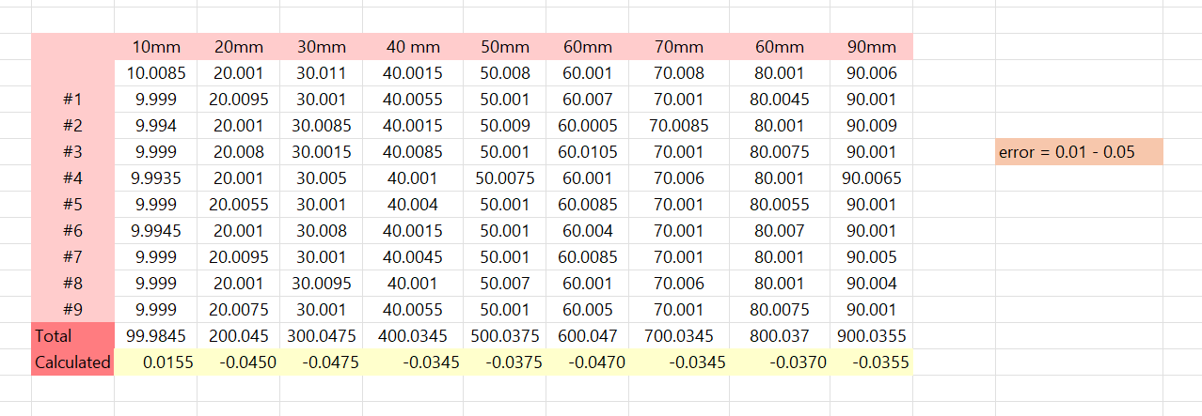
1. Find error of translation stage
Home position can’t change.
Home position is 0.0000 .
Moving translation stage into steps for find error of stage .
Error of translation stage is 0.0100 – 0.0500 .
13

Slide 16
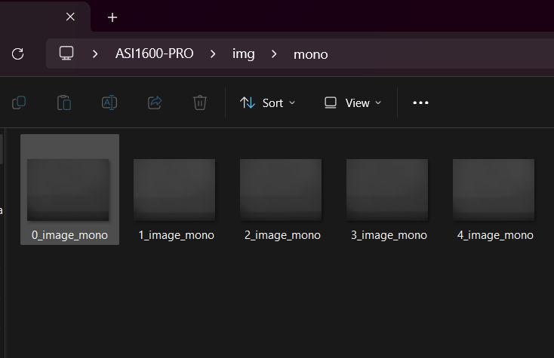
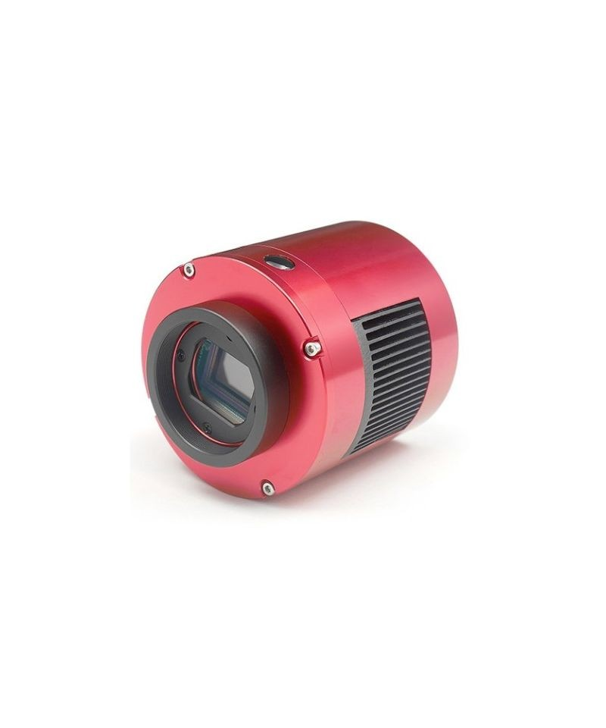
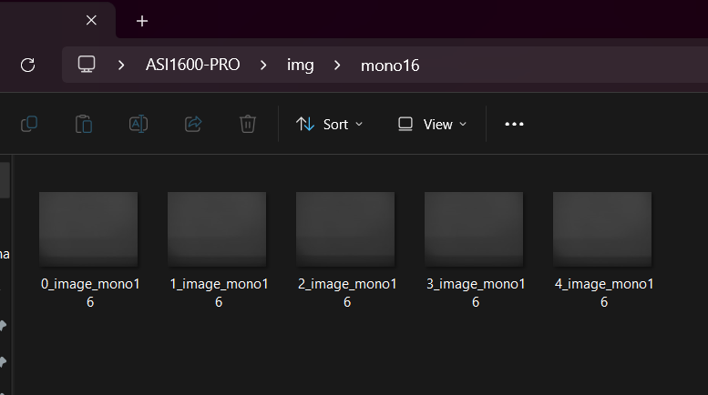
2. Capture image from camera
Try capture some image from ASI1600-PRO Camera and save images into .jpg for MONO8 and .tiff file. For MONO16
https://www.tecnosky.eu/index.php/zwo-asi-1600mm-pro-usb-3-0-cooled-mono.html
14

Slide 17
03
Error Measurement Method
15

Slide 18
START
Capture reference image
Capture image
WORKFLOW
Mainly focus on
Find error distance between 2 circles
Find distance between 2 circles
Normalized pixels to millimeters
No
Find solution for overlapped circles condition
PID CONTROL
Circles close to reference ?
Yes
FINISH
16
Notes:
Flowchart

Slide 19
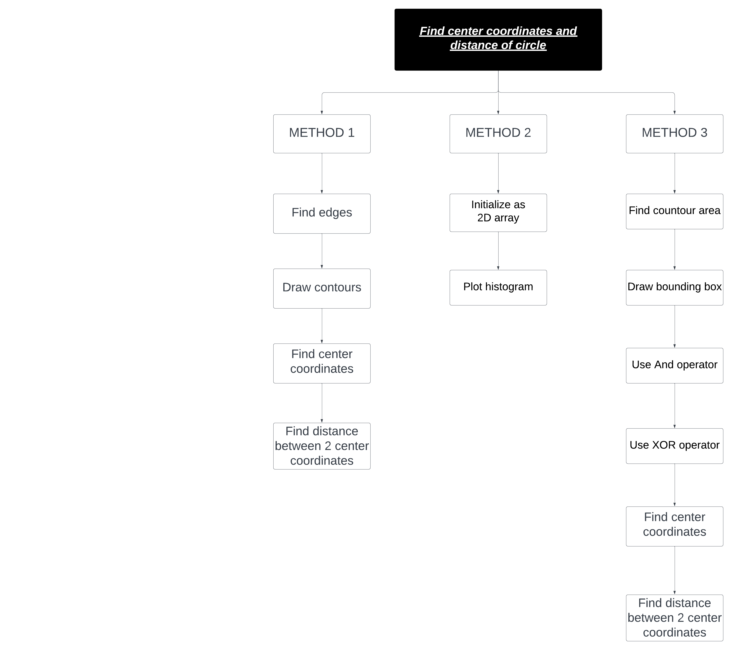
OVERVIEW MAP
17

Slide 20
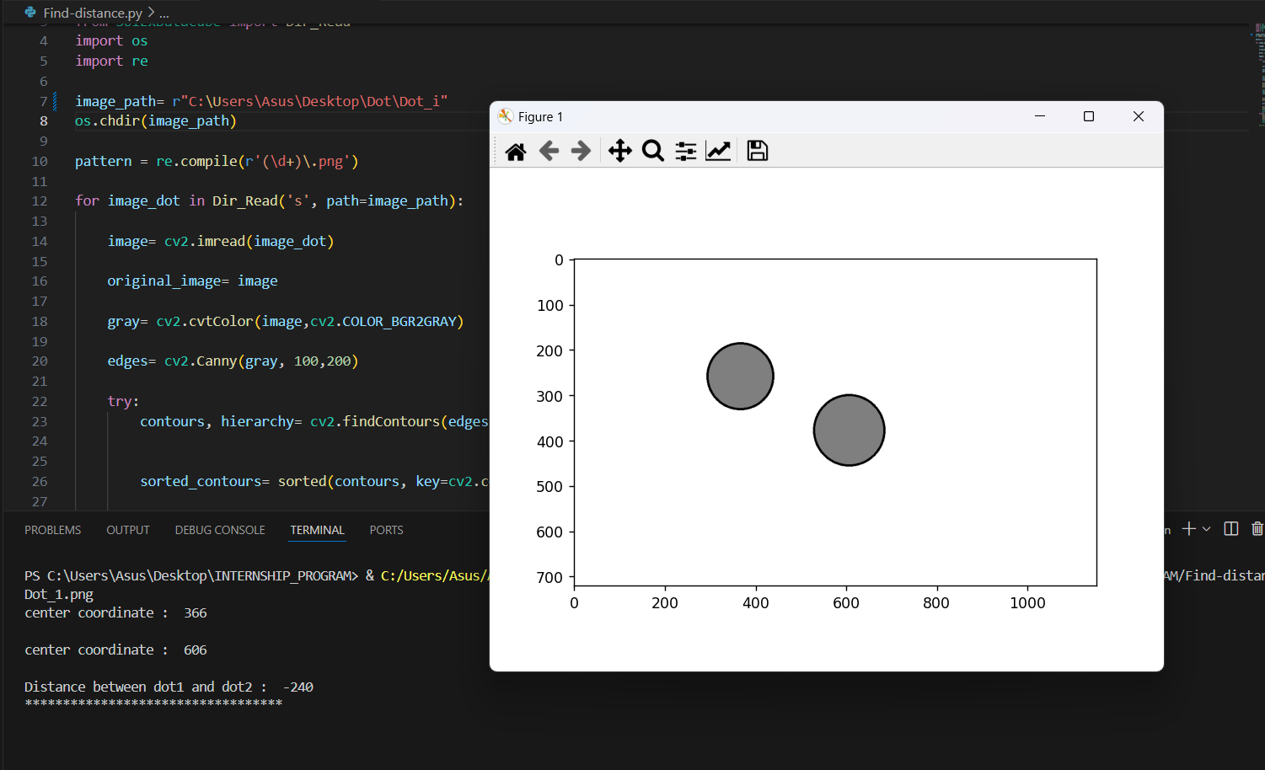
3. Find center coordinates and distance of circle
METHOD 1
1. Find center coordinates of circle by
Using OpenCV for find edge , contour area and coordinate of center point.
Use Matplotlib for plot circle.
2. Find distance between 2 circle by
1.Find coordinate of center of 2 circles
2.Subtrac coordinate of center of 2 circles
18

Slide 21
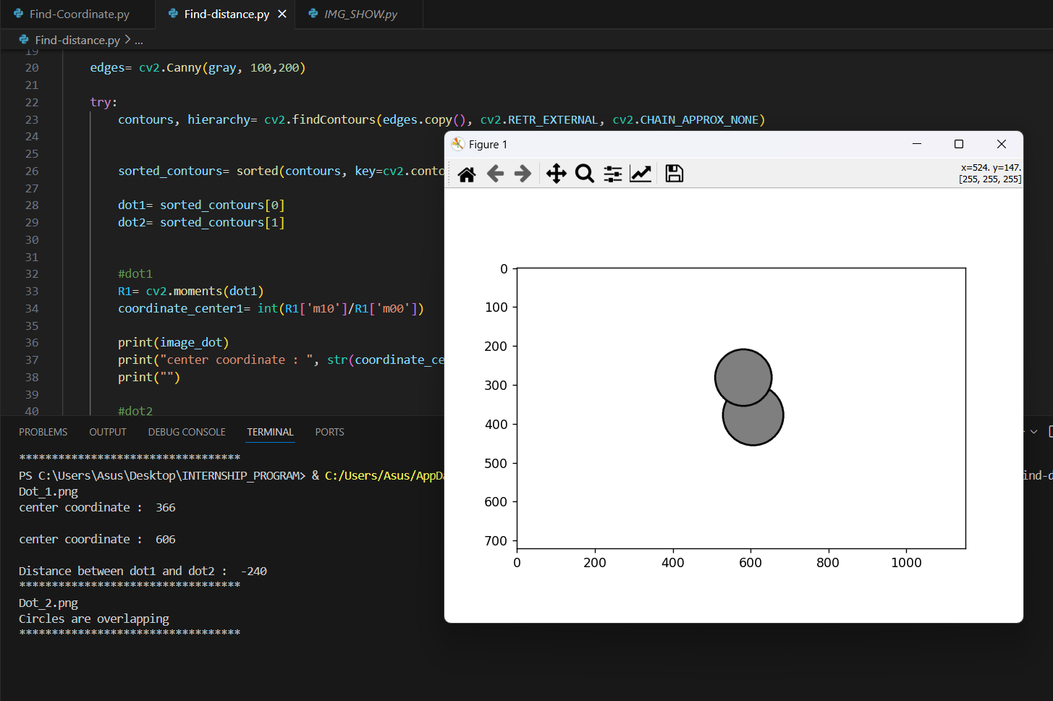
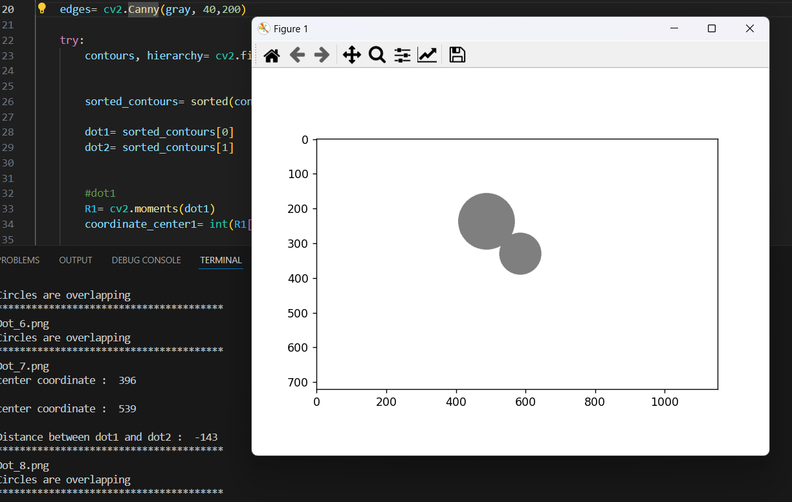
3. Find center coordinates and distance of circle
METHOD 1
Can’t use this condition with image that has 2 circles that are overlapping
19

Slide 22
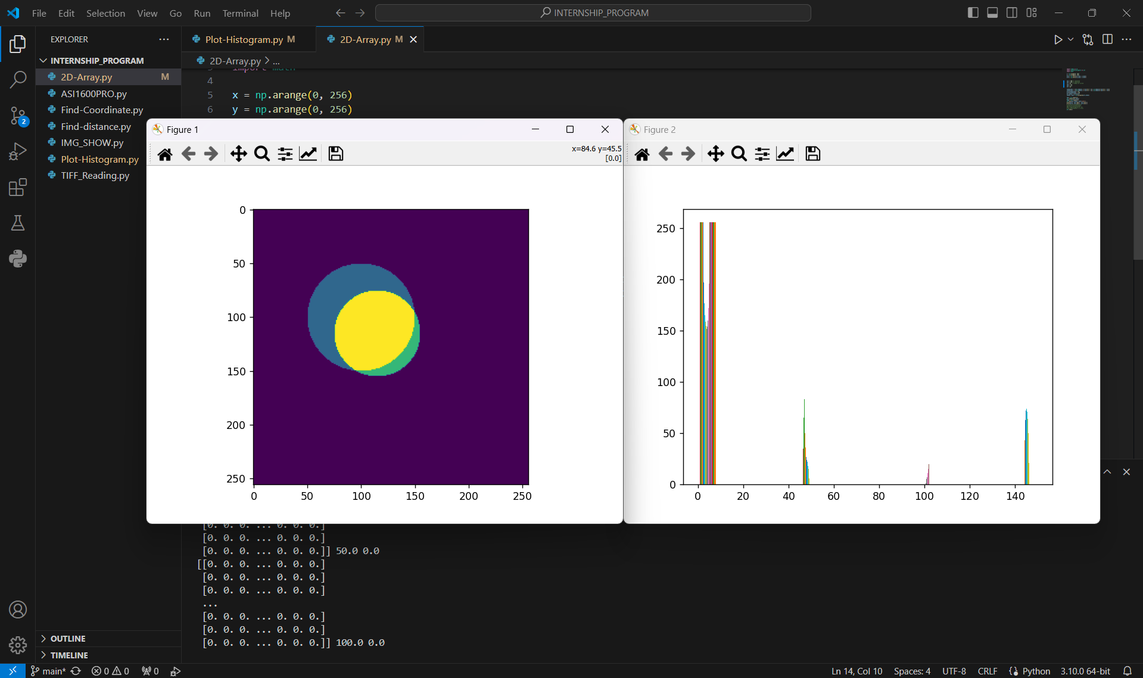
3. Find center coordinates and distance of circle
METHOD 2
Coding program for draw and plot circles from circle formula .
Initialize as 2D array .
Plot histogram for see intensity of circle
Can’t find distance between 2 images.
This code works for overlapped circle condition .
20

Slide 23
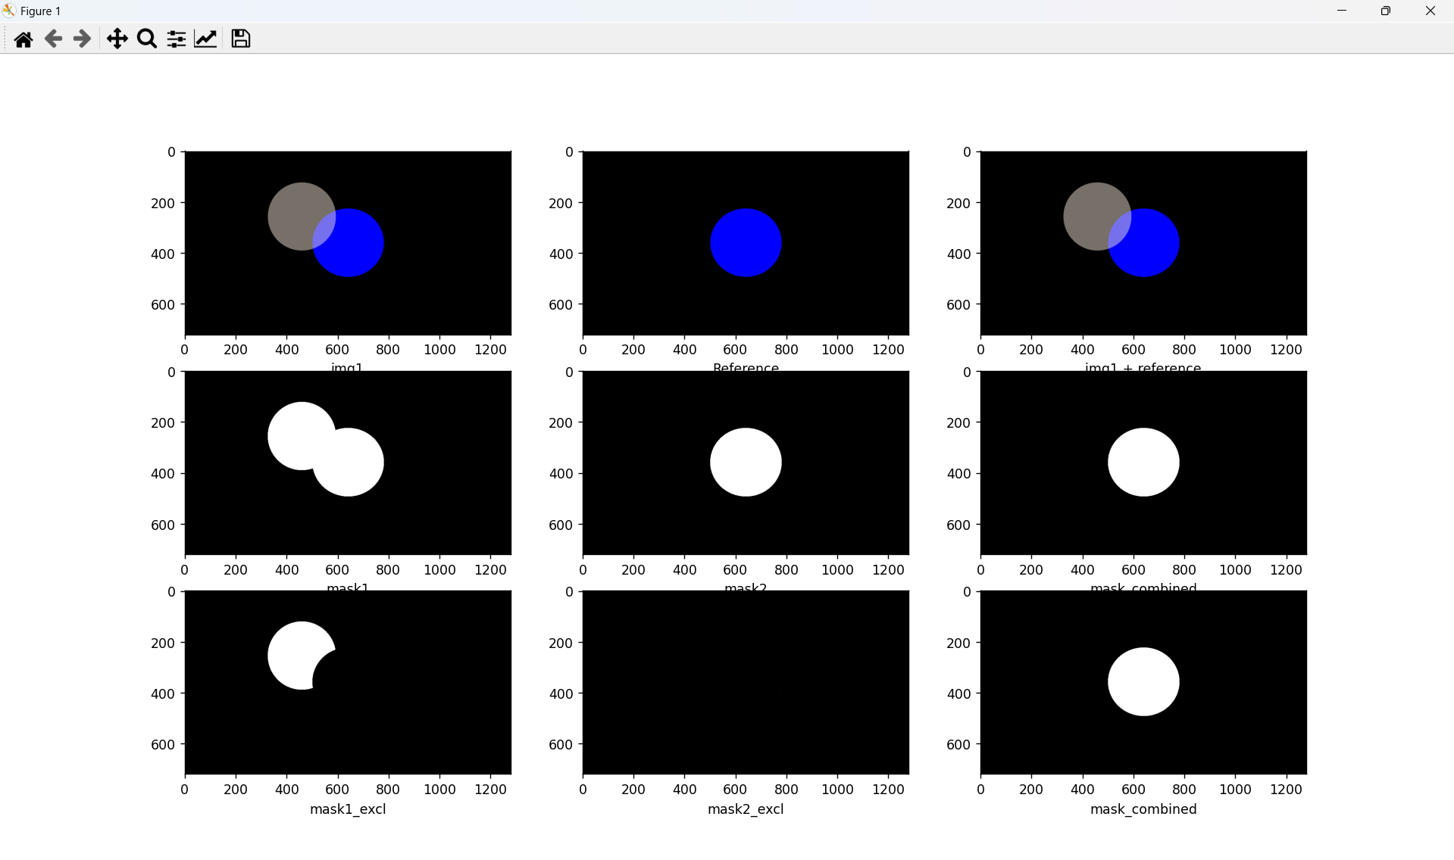
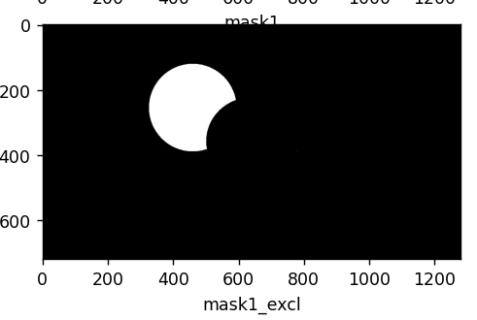
METHOD 3
3. Find center coordinates and distance of circle
AND
XOR
Main idea of this concept is
Use bitwise operation (AND , XOR) for find contour area that not overlapping. Then draw bounding box around the area then find height and width then calculate center of the area from height and width. Then find distance between 2 center point.
21
Notes:
บอกว่าใช้method3 ในการใช้จริง

Slide 24
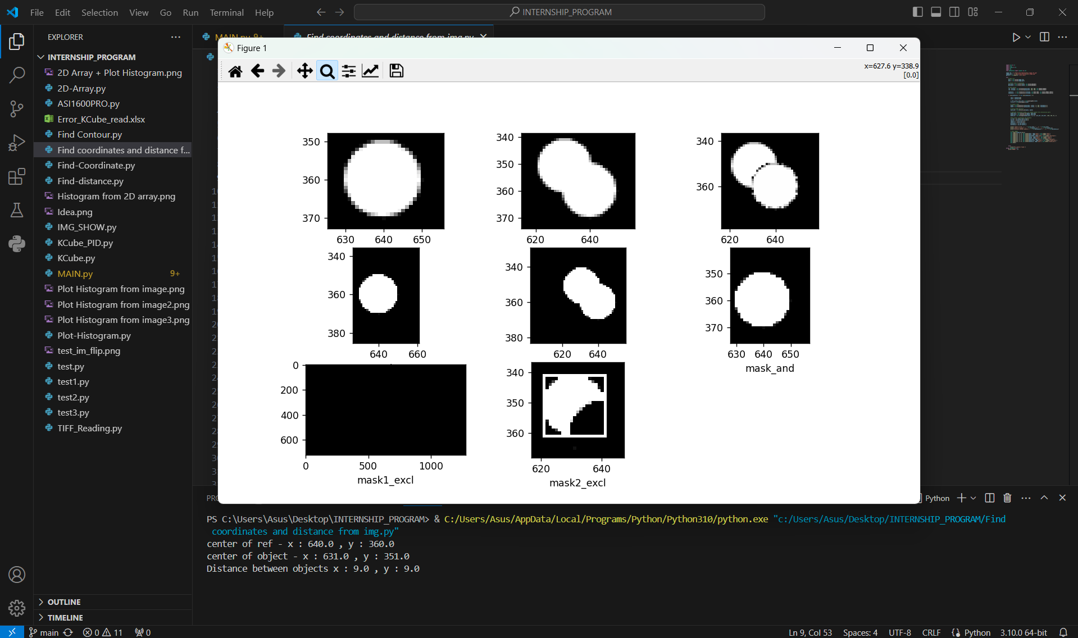
METHOD 3
3. Find center coordinates and distance of circle
22
Notes:
Using image that collected from lab for testing method 3

Slide 25
METHODS | ADVANTAGES | DISADVANTAGES
Contour area | Easy for operate | Can’t use this method with overlapped images
Histogram plot | Can use this method with overlapped images | Can’t find distance between 2 images.
Bitwise operation | Can use this method with overlapped images | Take more time to process
23

Slide 26
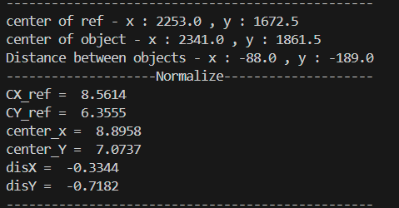
Normalized data from pixel to mm.
24

Slide 27
04
Experiment & Application
25

Slide 28
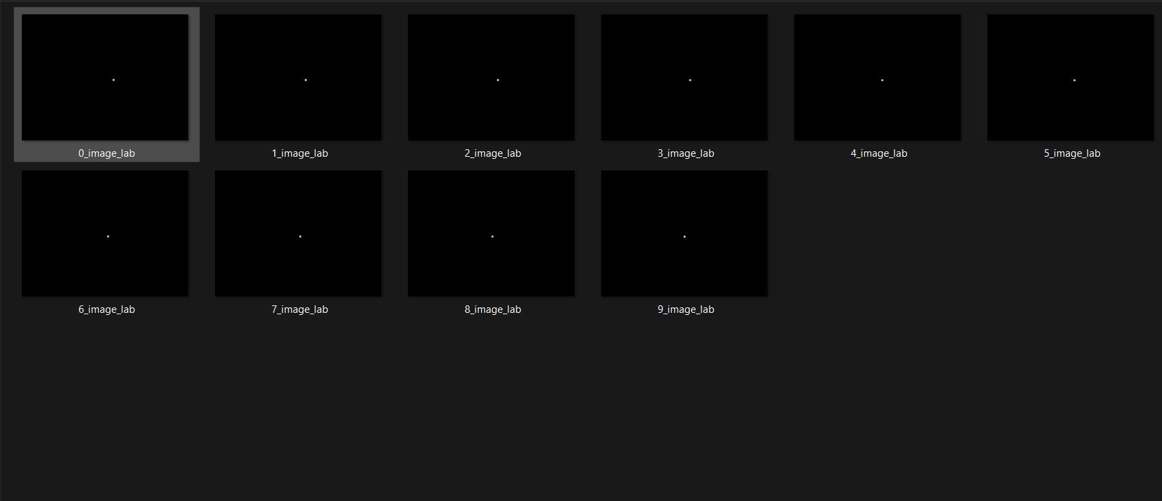
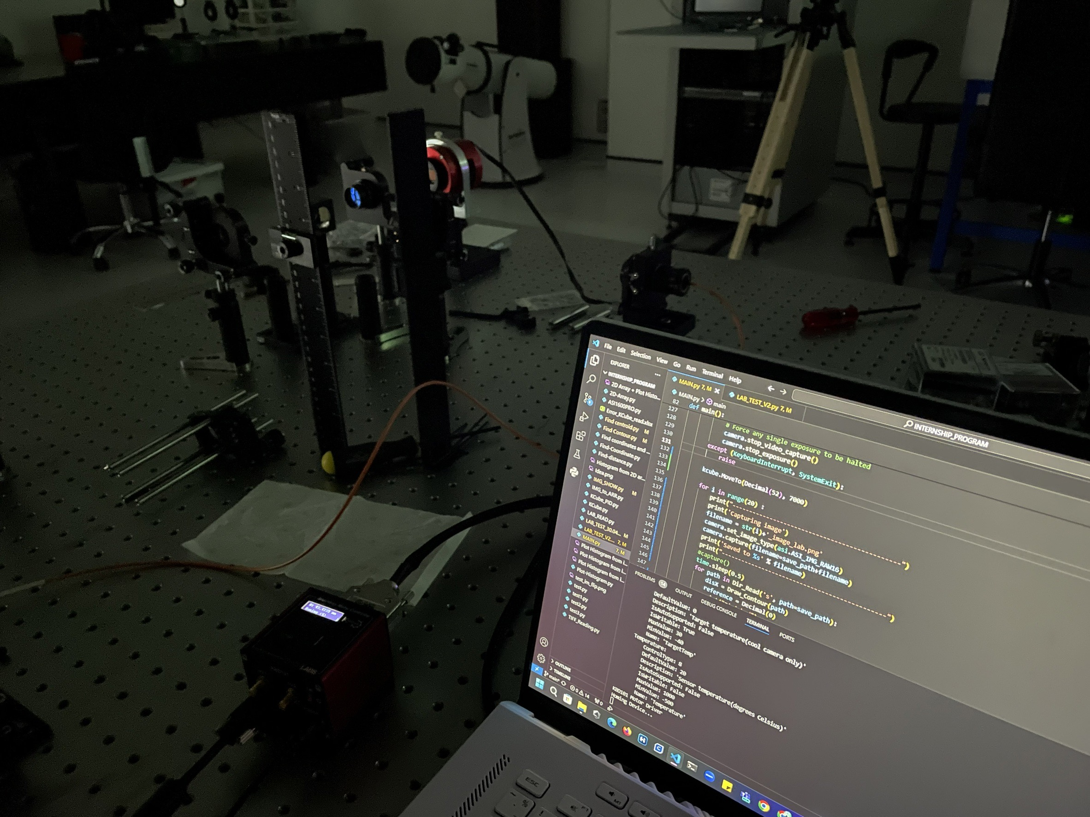
EXPERIMENT
Test code in lab with method 3 as solution for collect real data and find possible issue when run in the actual setup .
26

Slide 29
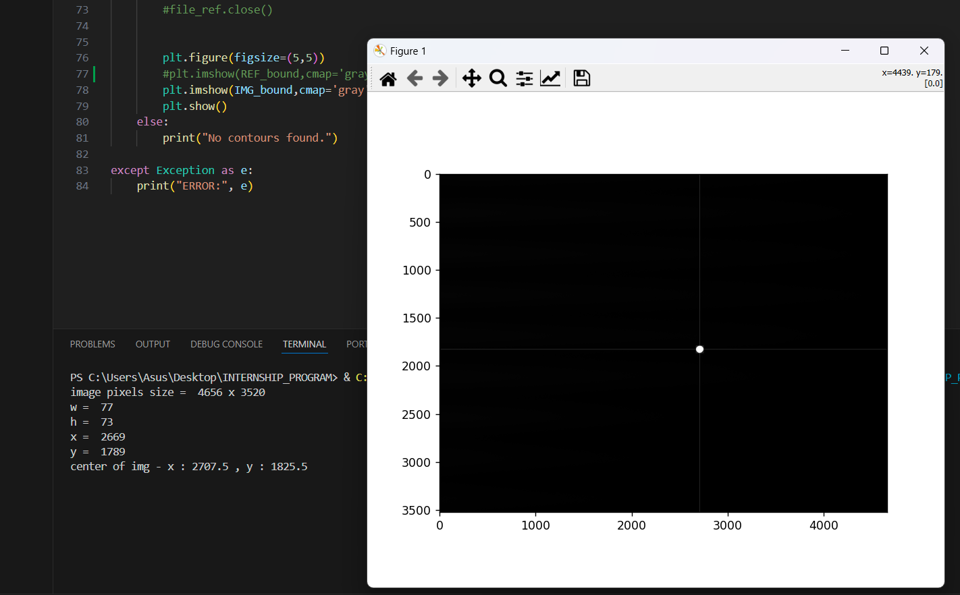
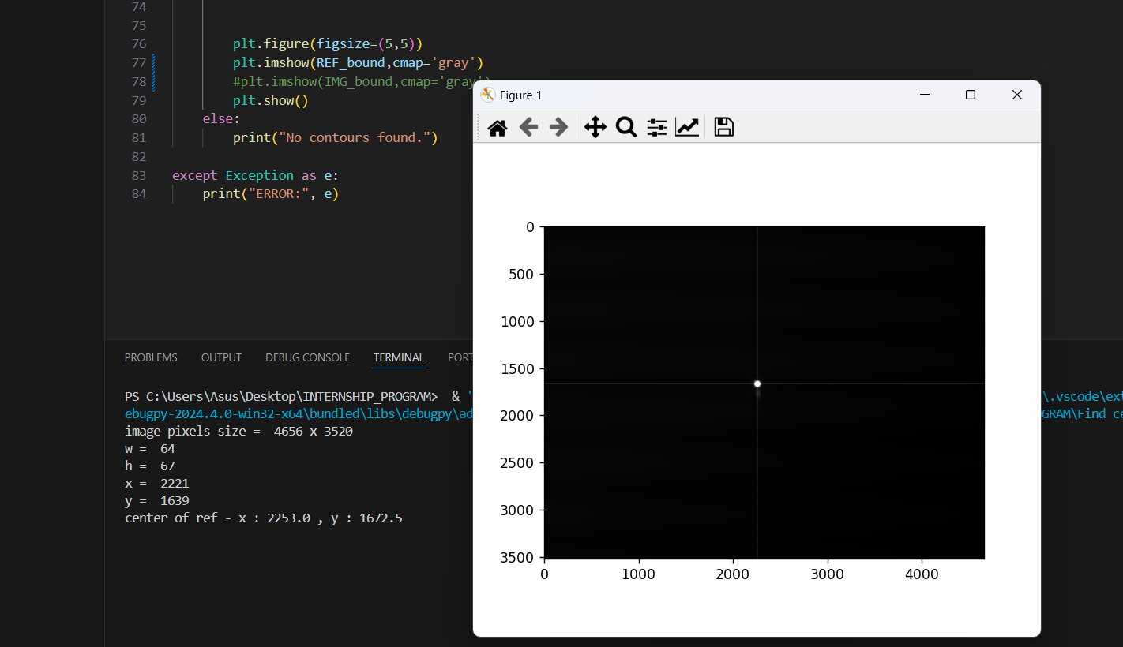
EXPERIMENT
Problem and solution 1
PROBLEM : Have only one light source
so it can’t see 2 dot in one image at the same time.
Solution
Find centroid and position of dot both in reference image and collected image.
Compare position of current image with reference image.
(Still use bitwise operation method in code for overlapped condition)
27

Slide 30
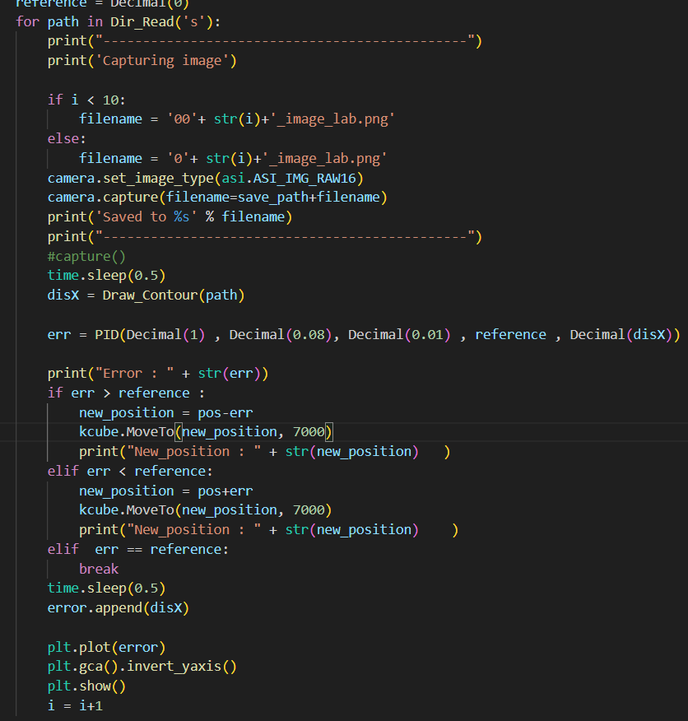
EXPERIMENT
Problem and solution 2
PROBLEM : Program doesn’t read current images that had capture . It’s read and overwrite old images in directory instead .
Solution : Coding new program that has infinite loop to read current images .
28

Slide 31
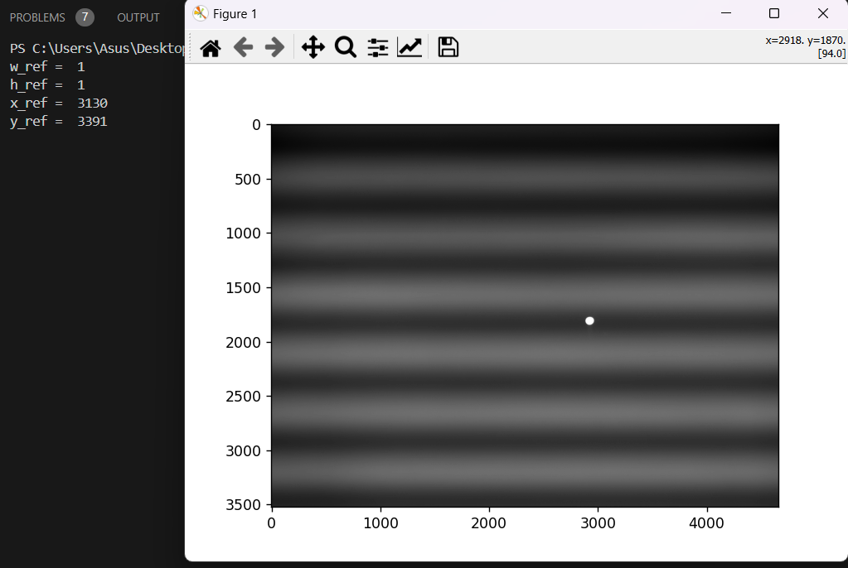
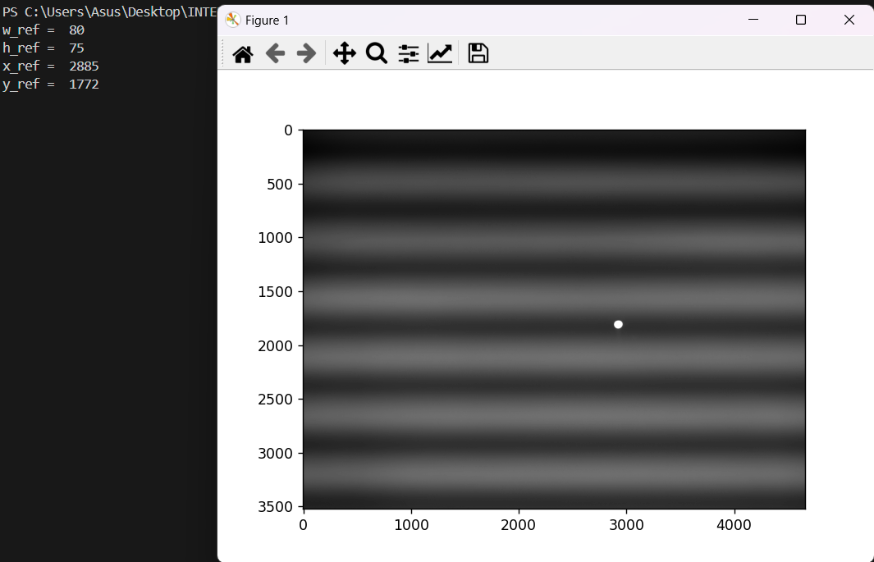
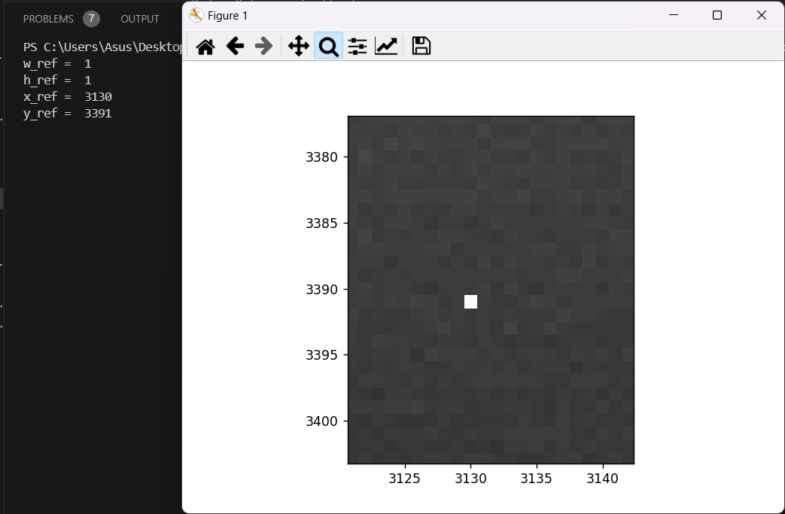
EXPERIMENT
Problem and solution 3
PROBLEM : Program read and draw wrong contour area . It’s read the random tiny pixels instead of the real reference pixels . So, it’s effect to calculate distance between current pixels and reference pixels.
Solution : Select and draw the biggest contour as reference pixels .
29

Slide 32
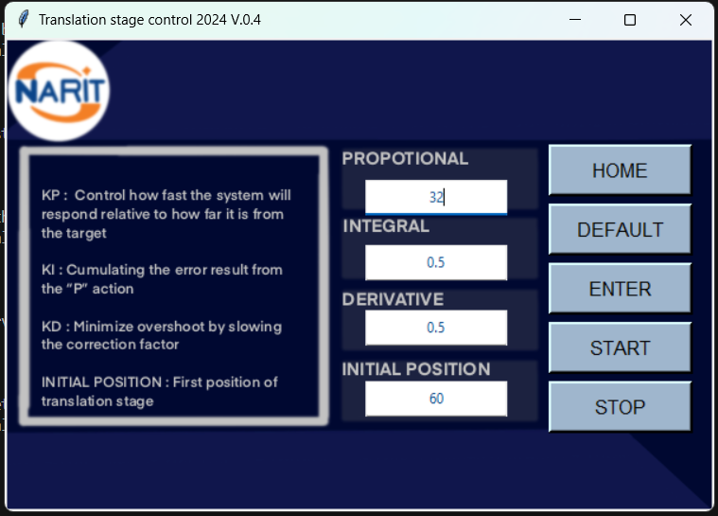
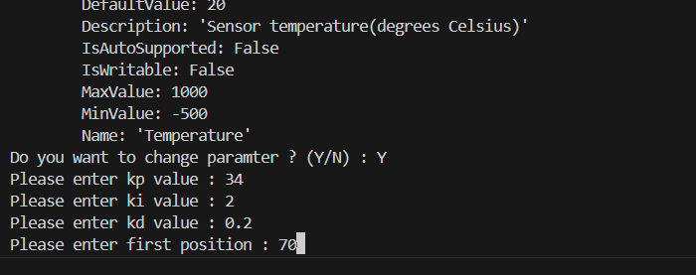
Application have 2 versions
UI Version
Command line Version
30

Slide 33
Application
Command line version for users.
31

Slide 34
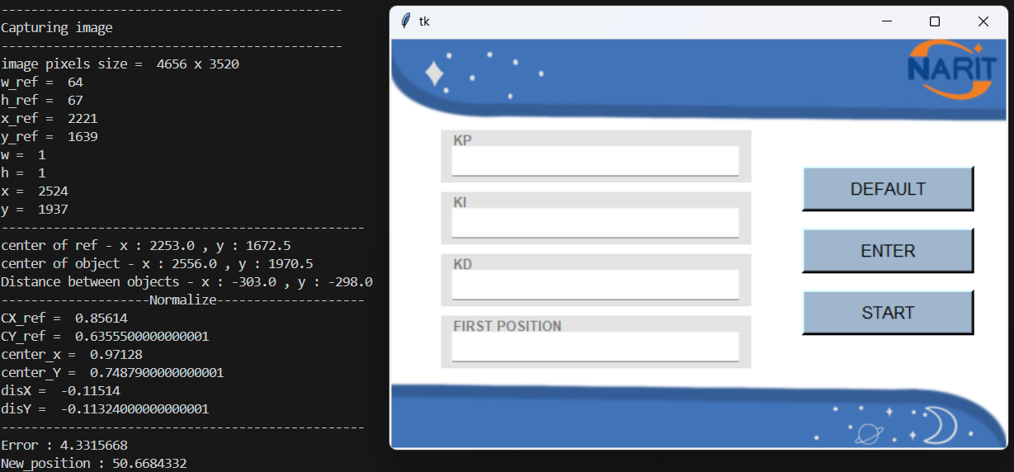
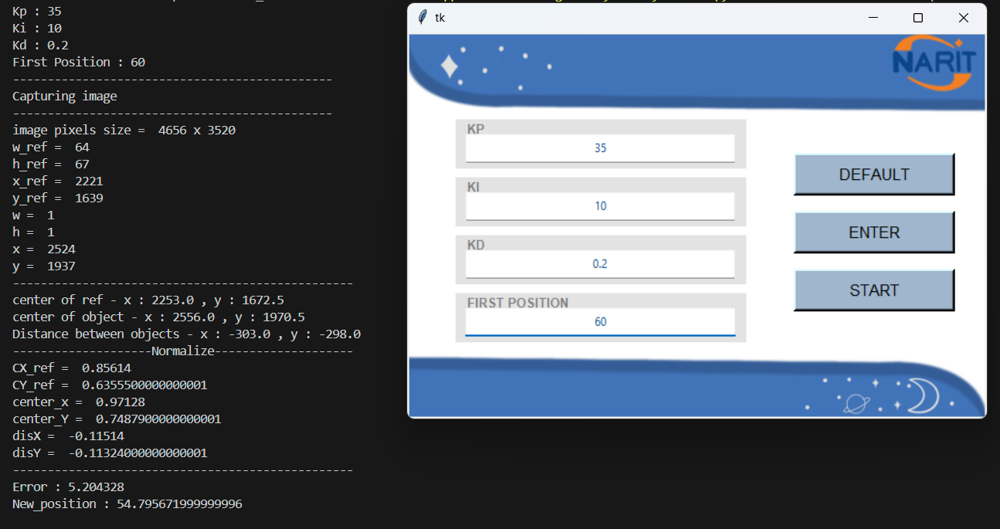
Application
First version of UI version
Have 2 options .
Option 1 : Enter values with default values.
Option 2 : Enter values with other values.
32

Slide 35
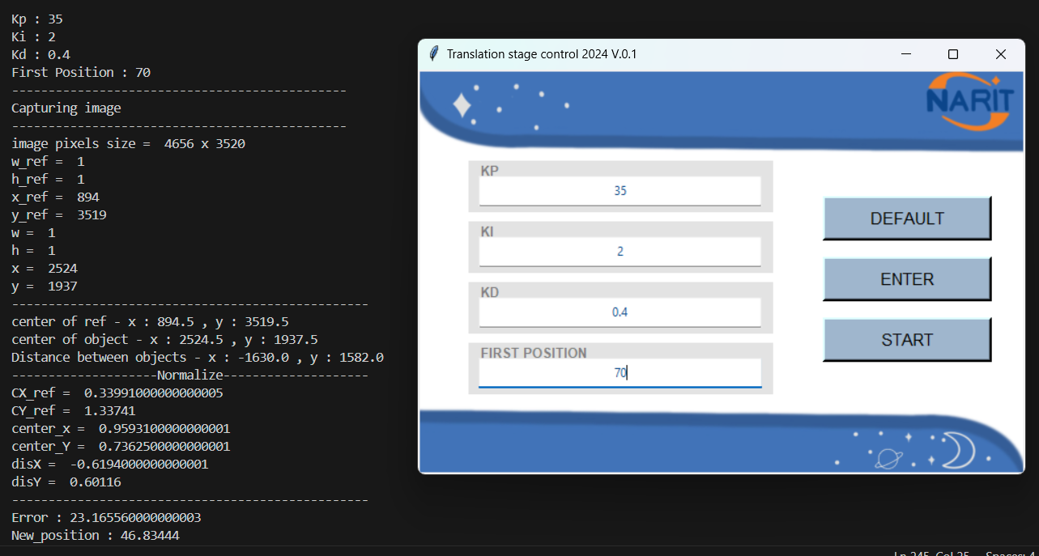
Collected feedback from users
Add the title of application
Display properly dynamic range of PID parameters
Create Stop and Home button
Initialize the PID parameters in entry boxes
Short describe for effect of each PID parameters
33

Slide 36
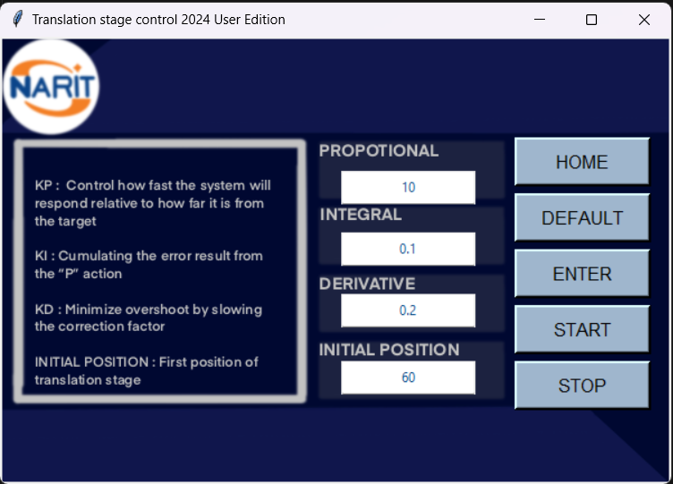
Current Version of application for users
Title of application
Initialized (Default)
PID parameters
Add Home button
Short description about PID parameters
Add stop button
34

Slide 37
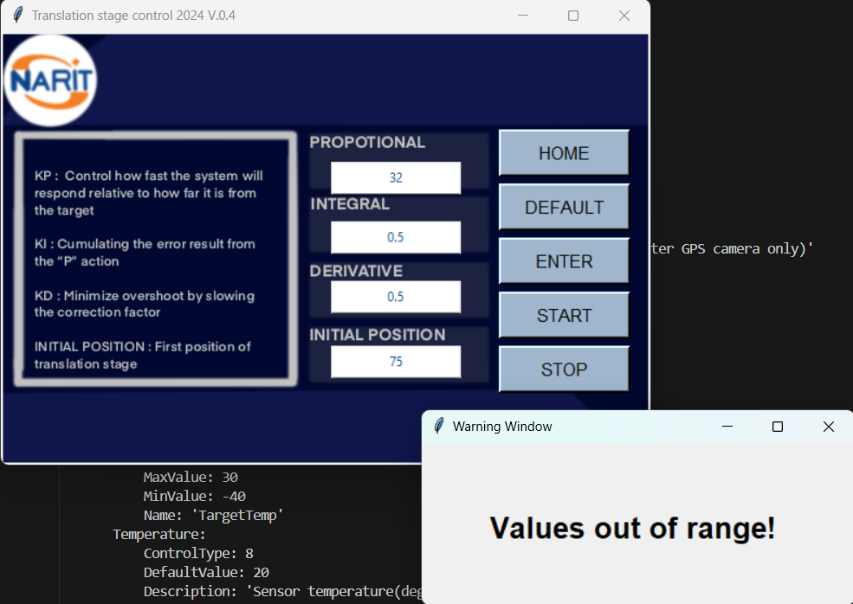
Add alert Window for notify when put some values that out of range.
The dynamic range of values is in README.md file
35

Slide 38
05
Conclusion
36

Slide 39
Block Diagram
Reference
PID
Translation
stage
Σ
Image
Processing
Camera
Achievement
Control translation stage with PID control
Find method for get error to calculate PID
Idea for develop in the future
Some graph doesn’t see difference between PID parameters enough because some of algorithm. Develop algorithm in the future
37

Slide 40
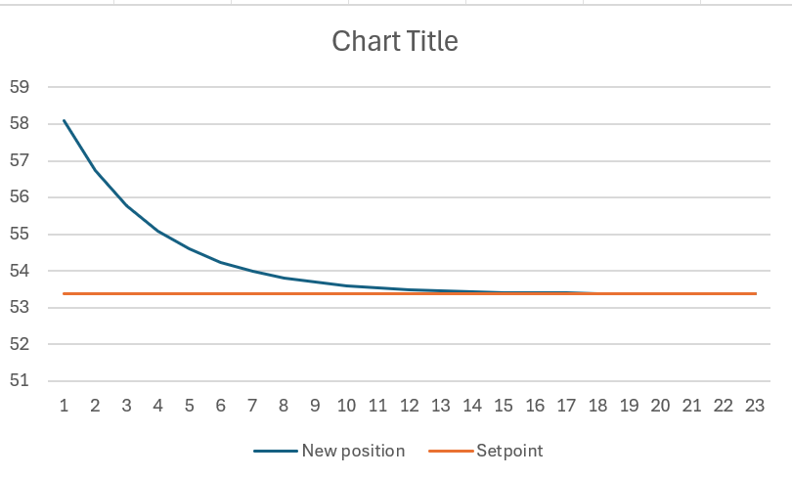
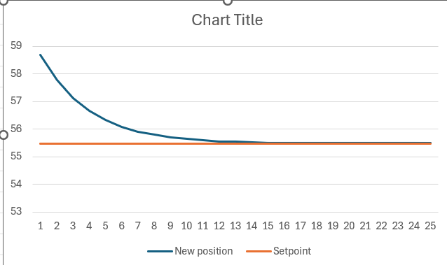
Default values of PID are :
P : Proportional : 10
I : Integral : 0.1
D : Derivative : 0.2
Initial position : 60
Application can work with the same PID values for difference reference position from different reference image .
Relation between translation stage position and setpoint
Relation between translation stage position and setpoint
mm
mm
Reference position = 53.37
Reference position = 55.48
38

Slide 41
Both UI version and input command in terminal version work successfully.
Can control translation stage with PID closed loop control and collect images.
UI Version
Command line Version
39

Slide 42
THANK YOU
Reference position = 55.48
40

